Slide 1
In the name of Allah, Most Gracious, Most Merciful
Paper Title
Computer Vision Based Industrial and Forest Fire Detection Using Support Vector Machine (SVM)
Authors
Md. Abdur Rahman, Sayed Tanimun Hasan, Mohammed Abdul Kader
Presented By
Sayed Tanimun Hasan
Department of Electrical & Electronic Engineering
International Islamic University Chittagong (IIUC)

Slide 2
ICISET-2022 Paper ID: 165 Slide No:

Slide 3
Introduction
Wildfires are one of the biggest catastrophes faced by our society today causing irrevocable damages.
These forest fires can be man-made or caused by mother nature by different weather conditions, torrential winds.
These fires cause damages not only to the environment they also destroy vast homes and property.
In industries, faced by many unwanted fire incident & losing…….
Hence we developed a system “Computer Vision Based Industrial & Forest Fire Detection Using Support Vector Machine (SVM)” to fight this disaster and help our planet.
ICISET-2022 Paper ID: 165 Slide No:

Slide 4
Literature Review
[2] T. Celik, “Fast and efficient method for fire detection using image processing,” ETRI journal, vol. 32, no. 6, pp. 881–890, 2010.
[3] T. Celik and K.-K. Ma, “Computer vision based fire detection in color images,” in2008 IEEE Conference on Soft Computing in Industrial Applications. IEEE, 2008, pp. 258–263.
[7] H. Wu, D. Wu, and J. Zhao, “An intelligent fire detection cameras based on computer vision methods,” Process Safetyand Environmental Protection, vol. 127, pp. 245–256, 2019.
ICISET-2022 Paper ID: 165 Slide No:

Slide 5
Problem Statement
Forest fires are one of the most worrisome natural disasters, destroying thousands of acres of forests and nearby urban zones, affecting plant and human life.
The forest fires are a fact of nature, and we have been serving as means of self-regulation of forests. However, these phenomena have become more frequent during the last years.
Besides, in industries we are facing unwanted fire incident. Fire extinguishers have existed for years but are still very difficult to maneuver. They are also very confusing when trying to use one in panic situation.
ICISET-2022 Paper ID: 165 Slide No:

Slide 6
Objectives
The main objective of the project is to develop a fire detection technique in real time. The main points of the project objectives are given below:
To detect fire while they are still small and have not grown too large.
To develop a low cost fire detection system in real time.
A system that detects a fire earlier than conventional fire detectors and more accurate.
ICISET-2022 Paper ID: 165 Slide No:

Slide 7
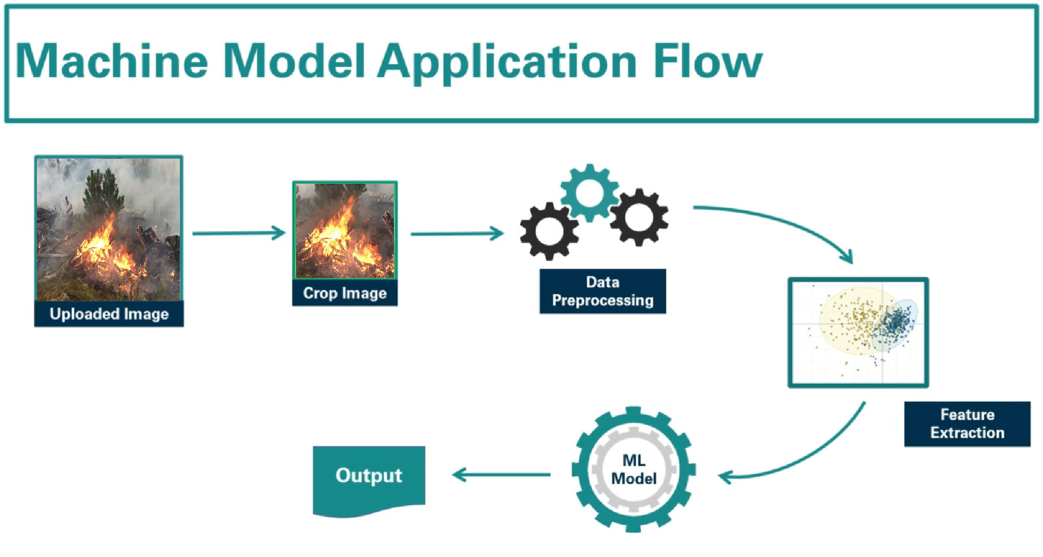
Methodology
ICISET-2022 Paper ID: 165 Slide No:

Slide 8
Methodology
Block Diagram
Motion Detection
Image Acquisition
(Webcam/Video/CCTV)
Image Enhancement
(Gaussian Blur Smoothing, HSV)
Detection using Fire Region Detection
Fire
No Fire
ICISET-2022 Paper ID: 165 Slide No:

Slide 9
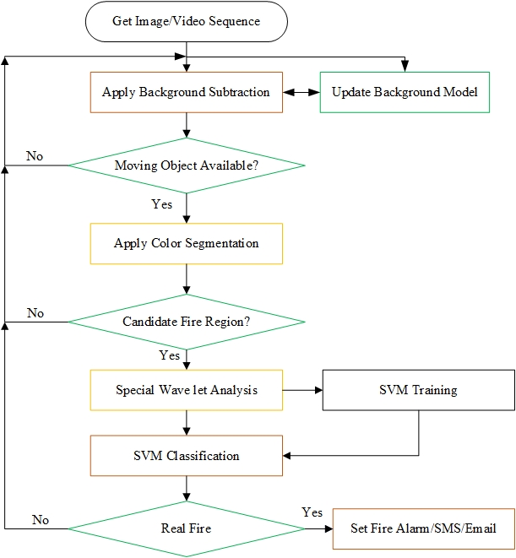
Methodology
Flowchart
ICISET-2022 Paper ID: 165 Slide No:

Slide 10
Methodology
Background Subtraction
To determine the motion region, Eq. (1)estimates the difference in contrast between the current image and the background image. A pixel at (x, y) is considered to be moving if it satisfies the conditions of Eq. (1), which areas follows.
ICISET-2022 Paper ID: 165 Slide No:

Slide 11
Methodology
Color Segmentation
To determine the motion region, Eq. (1)estimates the difference in contrast between the current image and the background image. A pixel at (x, y) is considered to be moving if it satisfies the conditions of Eq. (1), which areas follows.
ICISET-2022 Paper ID: 165 Slide No:

Slide 12
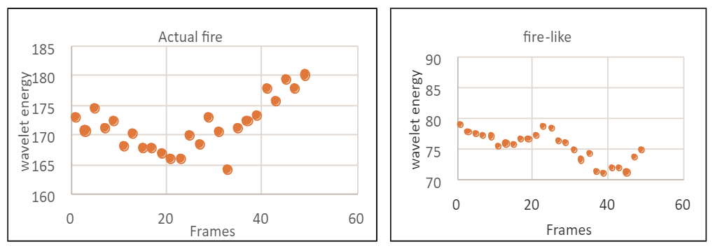
Methodology
Spatial Wavelet Analysis
ICISET-2022 Paper ID: 165 Slide No:

Slide 13
Methodology
Support Vector Machine Classifier
https://towardsdatascience.com/support-vector-machines-explained-25a685e4d228
ICISET-2022 Paper ID: 165 Slide No:

Slide 14
Design
ICISET-2022 Paper ID: 165 Slide No:

Slide 15
Result & Analysis
ICISET-2022 Paper ID: 165 Slide No:

Slide 16
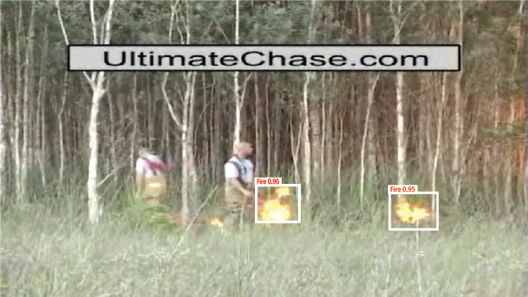
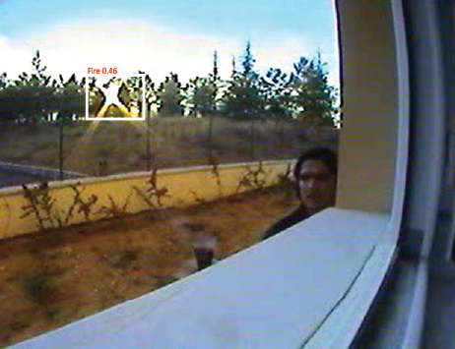
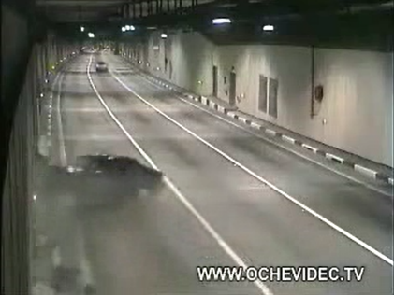
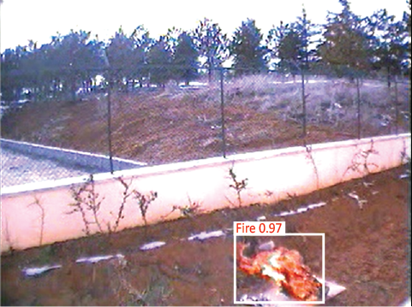
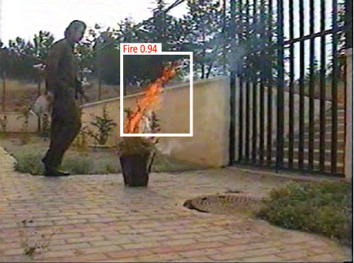
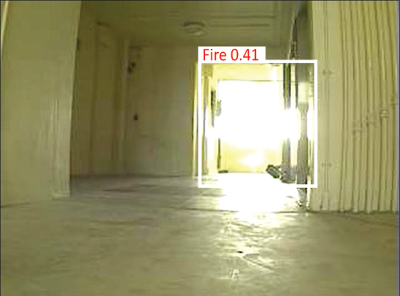
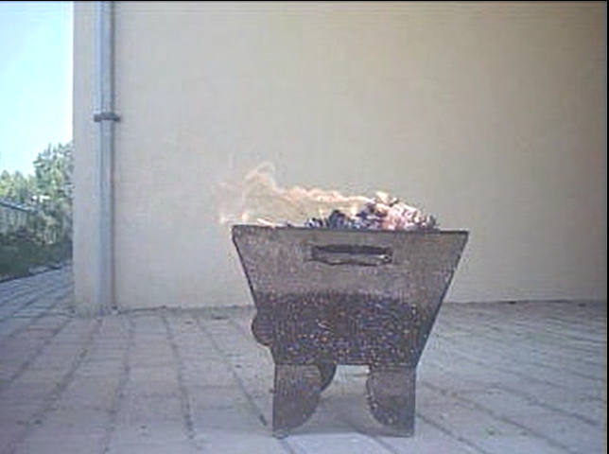
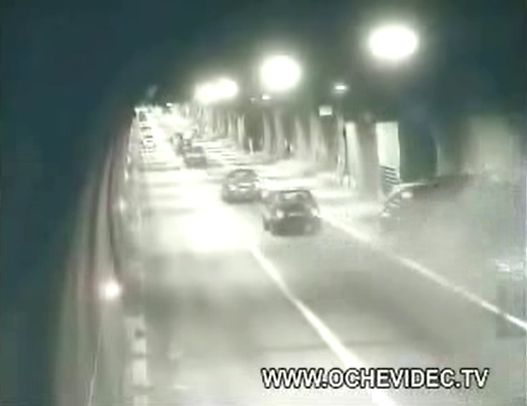
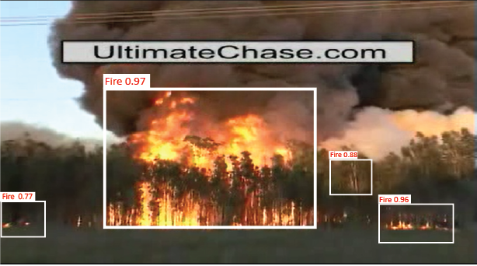
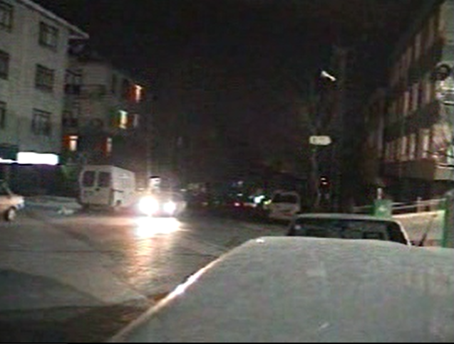
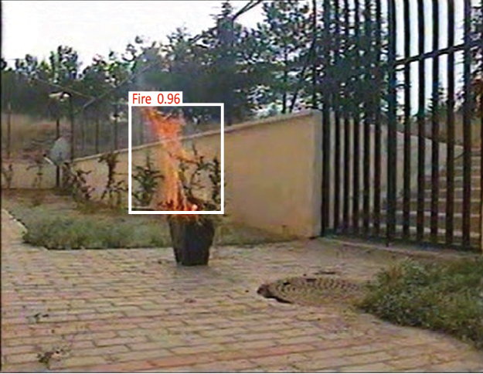
Outcome and Impacts
ICISET-2022 Paper ID: 165 Slide No:

Slide 17
Conclusion
The proposed system can successfully detect fire in real-time. The maximum recognition rate is 93.33%.
The proposed method is being tested by some popular and realistic dataset which collect Bilkent University, Signal Processing Lab, in order to see how well it works in practice.
In order to training the Support Vector Machine (SVM), a dataset comprising of 500 wavelet energies extracted from genuine fire video as well as 500 moving pixels that looked like fire and did not look like fire was utilized.
ICISET-2022 Paper ID: 165 Slide No:

Slide 18
Future Work
Integrate live satellite data and process real time processing of the fires .
Enhance the time complexity of the detection of fires to improve the speed.
ICISET-2022 Paper ID: 165 Slide No:

Slide 19
References
[1] A. Pathak, A. Tasin, A. Esho, A. Munna, and T. Chowdhury, “A smart semi-autonomous fire extinguish quadcopter: future of bangladesh,”Int.J. Adv. Res, vol. 8, pp. 01–15, 2020.
[2] T. Celik, “Fast and efficient method for fire detection using image processing,”ETRI journal, vol. 32, no. 6, pp. 881–890, 2010.
[3] T. Celik and K.-K. Ma, “Computer vision based fire detection in color images,” in2008 IEEE Conference on Soft Computing in Industrial Applications. IEEE, 2008, pp. 258–263.
[4] P. Foggia, A. Saggese, and M. Vento, “Real-time fire detection for video-surveillance applications using a combination of experts based on color, shape, and motion,”IEEE TRANSACTIONS on circuits and systems forvideo technology, vol. 25, no. 9, pp. 1545–1556, 2015.
[5] W. Jiayun, “Real-time visual detection of early manmade fire,” in 2015 IEEE International Conference on Information and Automation. IEEE,2015, pp. 993–997.
[6] B. Jiang, Y. Lu, X. Li, and L. Lin, “Towards a solid solution of real-time fire and flame detection,” Multimedia Tools and Applications, vol. 74,no. 3, pp. 689–705, 2015.
ICISET-2022 Paper ID: 165 Slide No:

Slide 20
References
[7] H. Wu, D. Wu, and J. Zhao, “An intelligent fire detection cameras based on computer vision methods,” Process Safetyand Environmental Protection, vol. 127, pp. 245–256, 2019.
[8] S. S. Moumgiakmas, G. G. Samatas, and G. A. Papakostas, “Computervision for fire detection on uavs—from software to hardware,”FutureInternet, vol. 13, no. 8, p. 200, 2021.
[9] K. Muhammad, J. Ahmad, and S. W. Baik, “Early fire detection usingconvolutional neural networks during surveillance for effective disastermanagement,”Neurocomputing, vol. 288, pp. 30–42, 2018.
[10] C. Filizzola, R. Corrado, F. Marchese, G. Mazzeo, R. Paciello, N. Per-gola, and V. Tramutoli, “Rst-fires, an exportable algorithm for early-fire detection and monitoring: Description, implementation, and fieldvalidation in the case of the msg-seviri sensor,”Remote Sensing ofEnvironment, vol. 186, pp. 196–216, 2016.
[11] C. Singh, E. Walia, and K. P. Kaur, “Enhancing color image retrievalperformance with feature fusion and non-linear support vector machineclassifier,”Optik, vol. 158, pp. 127–141, 2018.
[12] Y. Sun, C. Xu, G. Li, W. Xu, J. Kong, D. Jiang, B. Tao, and D. Chen,“Intelligent human computer interaction based on non redundant emgsignal,”Alexandria Engineering Journal, vol. 59, no. 3, pp. 1149–1157,2020.
ICISET-2022 Paper ID: 165 Slide No:

Slide 21
References
[13] M. Kang, T. X. Tung, and J.-M. Kim, “Efficient video-equipped fire de-tection approach for automatic fire alarm systems,”Optical Engineering,vol. 52, no. 1, p. 017002, 2013.
[14] M. A. I. Mahmoud and H. Ren, “Forest fire detection and identificationusing image processing and svm,”Journal of Information ProcessingSystems, vol. 15, no. 1, pp. 159–168, 2019.
[15] B. U. Töreyin, Y. Dedeo ̆glu, U. Güdükbay, and A. E. Cetin, “Computervision based method for real-time fire and flame detection,”Patternrecognition letters, vol. 27, no. 1, pp. 49–58, 2006.
[16] S. Theodoridis, A. Pikrakis, K. Koutroumbas, and D. Cavouras,Intro-duction to pattern recognition: a matlab approach.Academic Press,2010.
[17] E. Cetin, “Computer vision based fire detection dataset.[online].”Avail-able: http://signal.ee.bilkent.edu.tr/VisiFire/, 2014
ICISET-2022 Paper ID: 165 Slide No:

Slide 22
Acknowledgement
This work has been done entirely on a volunteer basis, and had not received any grants or funds from any organization or individual. We would like to express our respect and appreciation to our supervisor Engr. Mohammed Abdul Kader for his guidance and reviewers for their insightful comments and feedback.
ICISET-2022 Paper ID: 165 Slide No:

